Slide 1
UDP Programming
RES, Lecture 6
Olivier Liechti

Slide 2
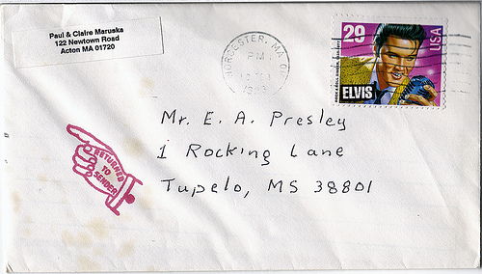
The UDP Protocol

Slide 3
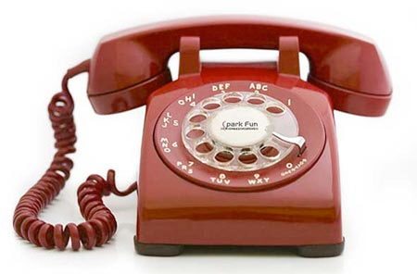

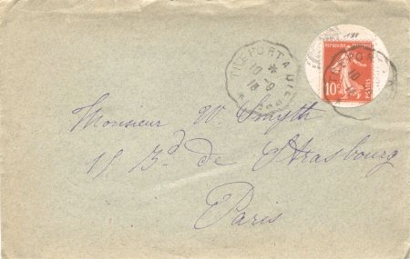
TCP
UDP

Slide 4
The UDP Protocol
When using UDP, you do not work with the abstraction of an IO stream.
Rather, you work with the abstraction of individual datagrams, which you can send and receive. Every datagram is independent from the others.
You do not have any guarantee: datagrams can get lost, datagrams can arrive out-of-order, datagrams can be duplicated.
What do you put “inside” the datagram (i.e. what is the payload)?
A notification.
A request, a query, a command. A reply, a response, a result.
A portion of a data stream (managed by the application).
What do you put “outside” of the datagram (i.e. what is the header)?
A destination address (IP address in the IP packet header + UDP port)
A source address (IP + port)

Slide 5



Unicast, Broadcast, Multicast
Destination Address
192.168.10.2
255.255.255.255
239.255.22.5
IANA Guidelines for IPv4 Multicast Address Assignments
http://tools.ietf.org/html/rfc5771

Slide 6

Messaging Patterns

Slide 7


Pattern: Fire-and-Forget
The sender generates messages, sends them to a single receiver or to a group of receivers.
The sender may do that on a periodic basis.
The sender does not expect any answer. He is telling, not asking.
notification
notification
notification

Slide 8

Pattern: Request-Reply
This pattern is used to implement the typical client-server model. Both the client and the server produce and consume datagrams.
The client produces requests (aka queries, commands). The client also listens for incoming replies (aka responses, results). The server listens for requests. The server also sends replies back to the client.
Can the client send a new request, even if he has not received the response to the previous request yet? If yes, and because UDP datagrams can be delivered out of order, how can the client associate a reply with the corresponding request?
request
3
request
2
request
1
reply
1
reply
3
reply
2

Slide 9
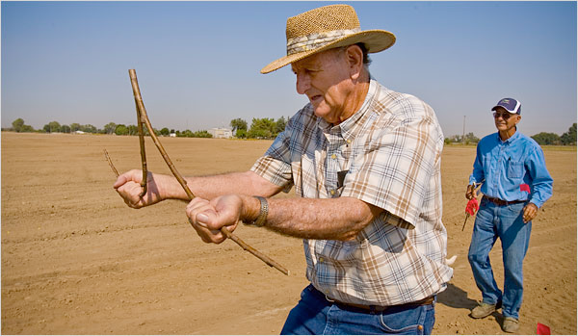
Service Discovery Protocols

Slide 10

Service Discovery Protocols
With unicast message transmission, the sender must know who the receiver is and must know how to reach it (i.e. know its address).
With broadcast and multicast, this is not required. The sender knows that nodes that are either nearby, or that have expressed their interest, will receive a copy of the message.
This property can be used to discover the availability of services or resources in a dynamic environment.

Slide 11

Model 1: Advertise Service Periodically
1
Service
Consumer
Service
Provider
“Hello Strangers.
I offer this service. You can reach me at this address.”
Client
Server
2
“Hello. I request the use of your service.”

Slide 12
Model 2: Query Service Availability
1
Service
Consumer
“Hello Strangers.
I am looking for someone who provides this service.
Service
Provider
2
“I offer the service you are looking for. You can reach me at this address.”
Client
Server
3
“Hello. I request the use of your service.”

Slide 13

Reliability

Slide 14
Reliability
UDP is not a reliable transport protocol:
Datagrams can arrive in a different order from which they were sent.
Datagrams can get lost.
For some application-level protocols, this is not an issue because they are tolerant to data loss. For example, think of a media streaming protocol.
But if no data loss can be tolerated at the application level (which is typically the case for file transfer protocols), does it mean that it is impossible to use UDP?

Slide 15
Who Is Responsible for Reliability?
It is actually possible to implement reliable application-level protocols on top of UDP, but...
It is the responsibility of the application-level protocol specification to include appropriate mechanisms to overcome the limitations of UDP.
It is the responsibility of the application developer to implement these mechanisms.
In other words, it is up to the application developer to “do the kind of stuff that TCP usually does”.
Do you remember about acknowledgments, timers, retransmissions, stop-and-wait, sliding windows, etc?

Slide 16
A First Example: TFTP
Trivial File Transfer Protocol (TFTP)
http://tools.ietf.org/html/rfc1350
“TFTP is a very simple protocol used to transfer files. It is from this that its name comes, Trivial File Transfer Protocol or TFTP. Each nonterminal packet is acknowledged separately. This document describes the protocol and its types of packets. The document also explains the reasons behind some of the design decisions.”
“Any transfer begins with a request to read or write a file, which also serves to request a connection. If the server grants the request, the connection is opened and the file is sent in fixed length blocks of 512 bytes. Each data packet contains one block of data, and must be acknowledged by an acknowledgment packet before the next packet can be sent.”

Slide 17
A Second Example: CoAP
Constrained Application Protocol (CoAP)
http://tools.ietf.org/html/draft-ietf-core-coap-18
“The Constrained Application Protocol (CoAP) is a specialized web transfer protocol for use with constrained nodes and constrained (e.g., low-power, lossy) networks. [...] The protocol is designed for machine-to-machine (M2M) applications such as smart energy and building automation.”
“CoAP provides a request/response interaction model between application endpoints, supports built-in discovery of services and resources, and includes key concepts of the Web such as URIs and Internet media types.”
“2.1. Messaging Model. The CoAP messaging model is based on the exchange of messages over UDP between endpoints. CoAP uses a short fixed-length binary header (4 bytes) that may be followed by compact binary options and a payload. This message format is shared by requests and responses. The CoAP message format is specified in Section 3. Each message contains a Message ID used to detect duplicates and for optional reliability. (The Message ID is compact; its 16-bit size enables up to about 250 messages per second from one endpoint to another with default protocol parameters.)
“4.2. Messages Transmitted Reliably. The reliable transmission of a message is initiated by marking the message as Confirmable in the CoAP header. [...] A recipient MUST acknowledge a Confirmable message with an Acknowledgement message [...].

Slide 18
Using the Socket API for a UDP Sender
1. Create a datagram socket (without giving any address / port)
2. Create a datagram and put some data (bytes) in it
3. Send the datagram via the socket, specifying the destination address and port
If a reply is expected:
4. Accept incoming datagrams on the socket
If we do not specify the port when creating the socket, the operating system will automatically assign a free one for us.
This port will be in the “source port” field of the UDP header. The receiver of our datagram will extract this value and will use it to send us the reply (it is a part of the return address.

Slide 19
Using the Socket API for a UDP Receiver
Application-level protocol specifications often define a standard UDP port, where the clients can send their requests. When this is the case, we have to specify the port number when creating the socket.
1. Create a datagram socket, specifying a particular port
2. Loop
2.1. Accept an incoming datagram via the socket
2.2. Process the datagram
2.3. If a reply is expected by the sender
2.3.1. Extract the return address from the request datagram
2.3.2. Prepare a reply datagram
2.3.3. Send the reply datagram via the socket
It is at this stage that we extract the source port and source IP address from the incoming datagram. We have found the return address, so we know where to the send the response.

Slide 20

Using UDP in Java

Slide 21
Using UDP in Java
java.net
DatagramSocket
DatagramPacket
MulticastSocket

Slide 22
// Sending a message to a multicast group
socket = new DatagramSocket();
byte[] payload = "Java is cool, everybody should know!!".getBytes();
DatagramPacket datagram = new DatagramPacket(payload, payload.length, InetAddress.getByName("239.255.3.5"), 4411);
socket.send(datagram);
Publisher (multicast)
Subscriber (multicast)
// Listening for broadcasted messages on the local network
MulticastSocket socket = new MulticastSocket(port);
InetAddress multicastGroup = InetAddress.getByName("239.255.3.5");
socket.joinGroup(multicastGroup);
while (true) {
byte[] buffer = new byte[2048];
DatagramPacket datagram = new DatagramPacket(buffer, buffer.length);
try {
socket.receive(datagram);
String msg = new String(datagram.getData(), datagram.getOffset(), datagram.getLength());
LOG.log(Level.INFO, "Received a datagram with this message: " + msg);
} catch (IOException ex) {
LOG.log(Level.SEVERE, ex.getMessage(), ex);
}
}
socket.leaveGroup(multicastGroup);

Slide 23
// Broadcasting a message to all nodes on the local network
socket = new DatagramSocket();
socket.setBroadcast(true);
byte[] payload = "Java is cool, everybody should know!!".getBytes();
DatagramPacket datagram = new DatagramPacket(payload, payload.length, InetAddress.getByName("255.255.255.255"), 4411);
socket.send(datagram);
Publisher
Subscriber
// Listening for broadcasted messages on the local network
DatagramSocket socket = new DatagramSocket(port);
while (true) {
byte[] buffer = new byte[2048];
DatagramPacket datagram = new DatagramPacket(buffer, buffer.length);
try {
socket.receive(datagram);
String msg = new String(datagram.getData(), datagram.getOffset(), datagram.getLength());
LOG.log(Level.INFO, "Received a datagram with this message: " + msg);
} catch (IOException ex) {
LOG.log(Level.SEVERE, ex.getMessage(), ex);
}
}

Slide 24
JavaScript 101

Slide 25
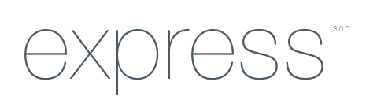





JavaScript - End to End
Client
Server

Slide 26
Experimenting with JavaScript
What do I need to write, execute and debug JavaScript code?
Should I work on the server side or on the client side?
Should I use a simple text editor or a complete IDE?
Should I rather use an online programming environment?
What kinds of developer tools, such as debuggers, are available?

Slide 27
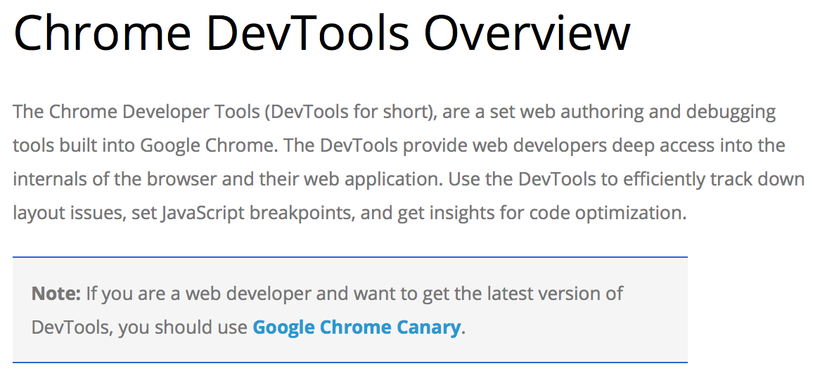

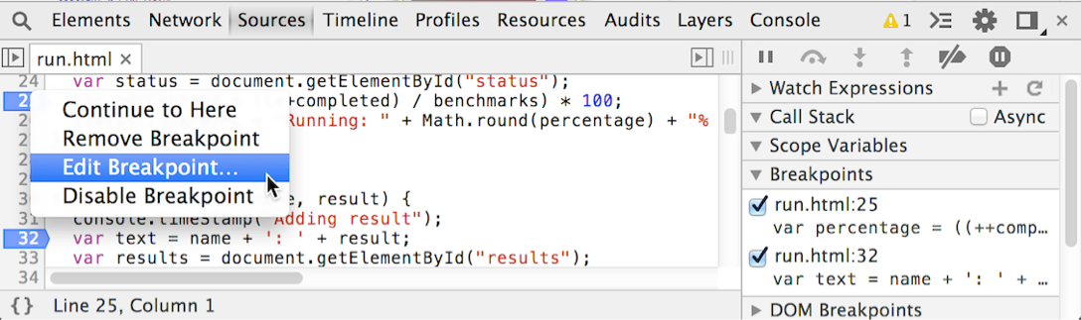
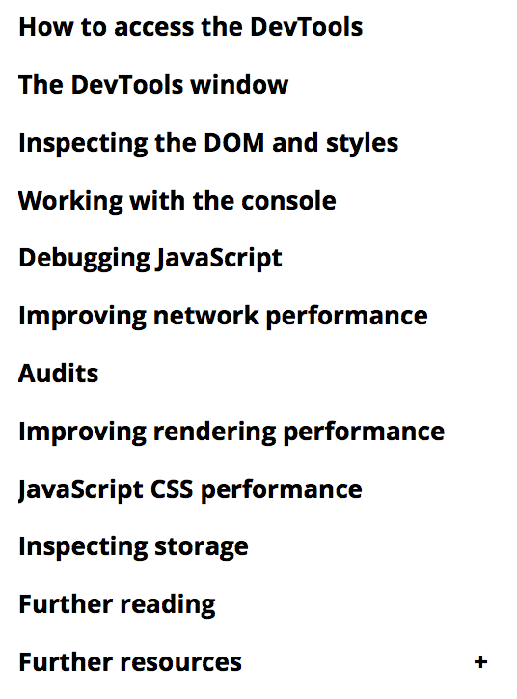
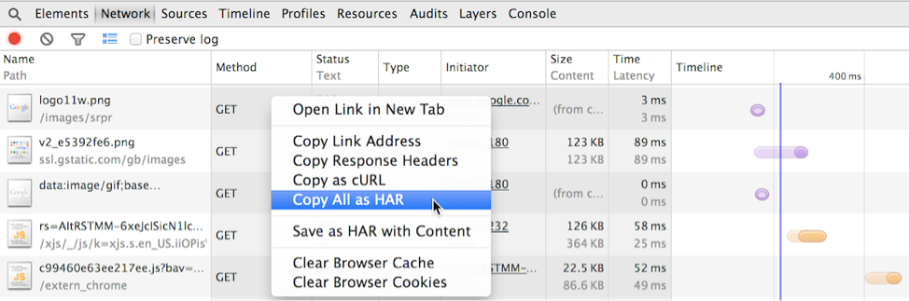
Browsers and Developers Tools
https://developer.chrome.com/devtools

Slide 28


“Node.js is a platform built on Chrome's JavaScript runtime for easily building fast, scalable network applications.
Node.js uses an event-driven, non-blocking I/O model that makes it lightweight and efficient, perfect for data-intensive real-time applications that run across distributed devices.”
not only!

Slide 29
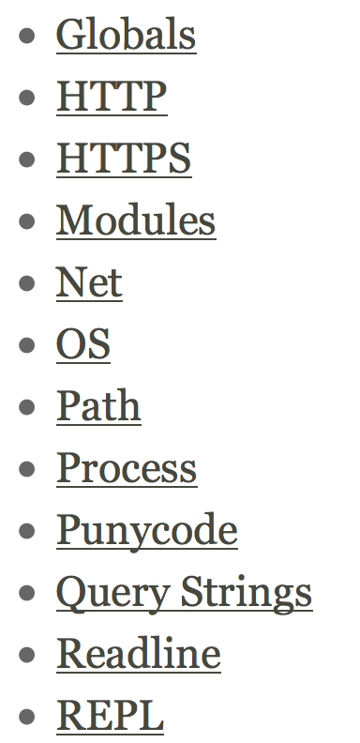
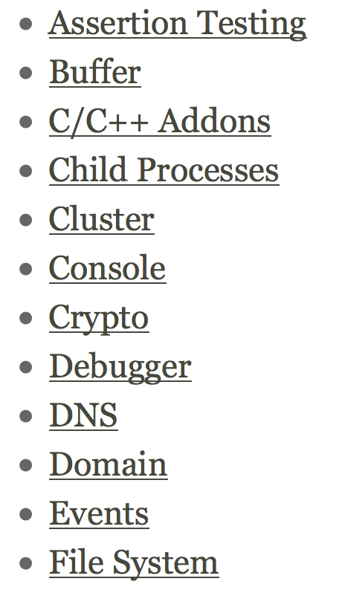
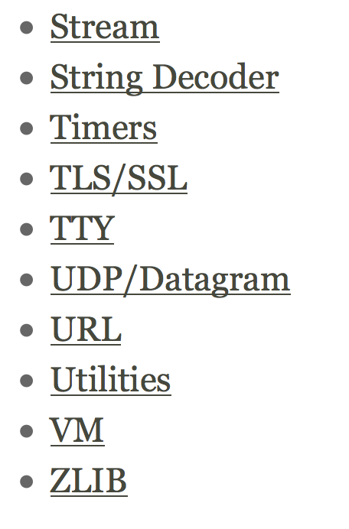

Slide 30
console.log(“hello”);
index.js
$ node index.js
hello

Slide 31
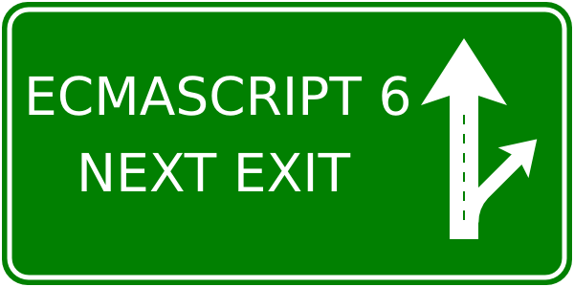
JavaScript 101
Types
Scopes
Objects
Prototypal inheritance
Functions
Constructors
Arrays
Things are changing... we do not cover ES 6 in these slides

Slide 32
JavaScript defines 6 types
const aNumber = 3.12;
const aBoolean = true;
const aString = "HEIG-VD";
const anObject = {
aProperty: null
};
// t is true for all of these:
var t;
t = typeof aNumber === "number";
t = typeof aBoolean === "boolean";
t = typeof aString === "string";
t = typeof anObject === "object";
t = typeof anObject.aProperty === "object";
t = typeof anObject.foobar === "undefined";
The 6 types are:
number
boolean
string
object
undefined
null
null is a type, but typeof null === object.
JavaScript is a dynamic language: when you declare a variable, you don't specify a type (and the type can change over time).
http://codepen.io/wasadigi/full/tJFoy/

Slide 33
Objects are dynamic bags of properties
// let's create an object
const person = {
firstName: 'olivier',
lastName: 'liechti'
};
// we can dynamically add properties
person.gender = 'male';
person['zip'] = 1446;
// and delete them
delete person.zip;
for (let key in person) {
console.log(key + " : " + person[key]);
};
There are different ways to access properties of an object.
JavaScript is dynamic: it is possible to add and remove properties to an object at any time.
Every object has a different list of properties (no class).
http://codepen.io/wasadigi/full/cmjGA

Slide 34
Before ES6, the language did not have
support for classes.
There are 3 ways to create objects
// create an object with a literal
const person = {
firstName: 'olivier',
lastName: 'liechti'
};
// create an object with a prototype
const child = Object.create(person);
// create an object with a constructor
const child = new Person(‘olivier’, ‘liechti’);
A constructor is function like any other (uppercase is a coding convention).
It is the use of the new keyword that triggers the object creation process.

Slide 35
Arrays are objects
var fruits = ["apple", "pear"];
fruits.push("banana");
console.log(Object.getPrototypeOf(fruits));
for (var i=0; i<fruits.length; i++) {
console.log("fruits[" + i + "] = " + fruits[i]);
}
var transformedFruits = fruits.map( function(fruit) {
return fruit.toUpperCase();
});
transformedFruits.forEach( function(fruit) {
console.log(fruit);
});
var count = fruits.reduce( function(val, fruit) {
console.log("reducer invoked with " + val);
return val+1;
}, 0);
console.log("There are " + count + " fruits in the array");
http://codepen.io/wasadigi/full/LtnAp/

Slide 36
Functions are objects
function aFunction() {
}
var f = function() {
}
var g = function g() {
g(); // recursive call
}
var h = function(functionParam) {
functionParam();
}
h(f);
h(g);

Slide 37
#1 Functions are objects
var aFunction = function() {
console.log("I am doing my job");
};
aFunction.aProperty = "aValue";
aFunction();
#2 Passing functions as arguments
var aFunction = function() {...};
var anotherFunction = function( f1 ) {... f1(); ...};
anotherFunction( aFunction );
#3 Return functions as values
var aFunction = function() {
return function() {...}
};
aFunction()();

Slide 38
Every object inherits from a prototype object
var person = {
firstName: "olivier",
lastName: "liechti"
};
// person’s prototype is Object.prototype
var father = {};
var child = Object.create(father);
// child’s prototype is father
function Person(fn, ln) {
this.firstName = fn;
this.lastName = ln;
}
var john = new Person("John", "Doe");
// john’s prototype is Person.prototype
http://codepen.io/wasadigi/full/nkIil

Slide 39
Every object inherits from a prototype object
prototype
prototype
Object.prototype
father
child
firstName : ‘olivier’
lastName : ‘liechti’
firstName : ‘sacha’
Every object inherits from a prototype object. It inherits and can override its properties, including its methods.
Objects created with object literals inherit from Object.prototype.
When you access the property of an object, JavaScript looks up the prototype chain until it finds an ancestor that has a value for this property.
console.log(child.lastName);
// prints ‘liechti’ on the console

Slide 40
With patterns, it is possible to implement
class-like data structures
badGreet is a property that will be replicated for every object created with the Person constructor:
poor memory management
not possible to alter behavior of all instances at once
greet is a property that will be shared by all instances (because it will be looked up along the object inheritance chain).
privateVar is not accessible outside of the constructor.
fistName is publicly accessible (no encapsulation).
function Person(fn, ln) {
var privateVar;
this.firstName = fn;
this.lastName = ln;
this.badGreet = function() {
console.log("Hi " + this.firstName);
};
};
Person.prototype.greet = function() {
console.log("Hey " + this.firstName);
};
var p1 = new Person("olivier", "liechti");
p1.badGreet();
p1.greet();
http://codepen.io/wasadigi/full/FeiAd/

Slide 41
Node.js 101

Slide 42



Let’s look at a first example (NOT good)
/*global require */
var fs = require("fs");
/**
* Simple function to test the synchronous readFileSync function provided by
* Node.js
* @param {string} filename - the name of the file we want to read in the test
*/
function testSyncRead(filename) {
console.log("I am about to read a file: " + filename);
var data = fs.readFileSync(filename);
console.log("I have read " + data.length + " bytes (synchronously).");
console.log("I am done.");
}
// We get the file name from the argument passed on the command line
var filename = process.argv[2];
console.log("\nTesting the synchronous call");
testSyncRead(filename);
This is for the Brackets editor
We use a standard Node module for accessing the file system
fs.readFileSync is synchronous: it blocks the main thread until the data is available.
process is a global object provided by Node.js
$ node sample2.js medium.txt
Testing the synchronous call
I am about to read a file: medium.txt
I have read 1024 bytes (synchronously).
I am done.
Synchronous functions are easier to use, but they have severe performance implications!!

Slide 43
Let’s look at a second example (BETTER)
/*global require */
var fs = require("fs");
/**
* Simple function to test the asynchronous readFile function provided by Node.js
* @param {string} filename - the name of the file we want to read in the test
*/
function testAsyncRead(filename) {
console.log("I am about to read a file: " + filename);
fs.readFile(filename, function (err, data) {
console.log("Nodes just told me that I have read the file.");
});
console.log("I am done. Am I really?????");
}
// We get the file name from the argument passed on the command line
var filename = process.argv[2];
console.log("\nTesting the asynchronous call");
testAsyncRead(filename);
fs.readFile is asynchronous: it does not block the main thread until the data is available.
We must provide a callback function, which Node.js will invoke when the data is available.
Problems can happen when an (asynchronous) function is called.
$ node sample2.js medium.txt
Testing the asynchronous call
I am about to read a file: medium.txt
I am done. Am I?
Nodes just told me that I have read the file.
Node.js developers have to learn the asynchronous programming style.

Slide 44
Let’s look at a third example
/*global require */
var http = require("http");
/**
* This function starts a http daemon on port 9000. It also
* registers a callback handler, to handle incoming HTTP
* requests (a simple message is sent back to clients).
*/
function runHttpServer() {
var daemon = http.createServer();
daemon.on("request", function (req, res) {
console.log("A request has arrived: URL=" + req.url);
res.writeHead(200, {
'Content-Type': 'text/plain'
});
res.end('Hello World\n');
});
console.log("Starting http daemon...");
daemon.listen(9000);
}
runHttpServer();
We use a standard Node module that takes care of the HTTP protocol.
Node can provide us with a ready-to-use server.
We can attach event handlers to the server. Node will notify us asynchronously, and give us access to the request and response.
We can send back data to the client.
We have wired everything, let’s welcome clients!

Slide 45
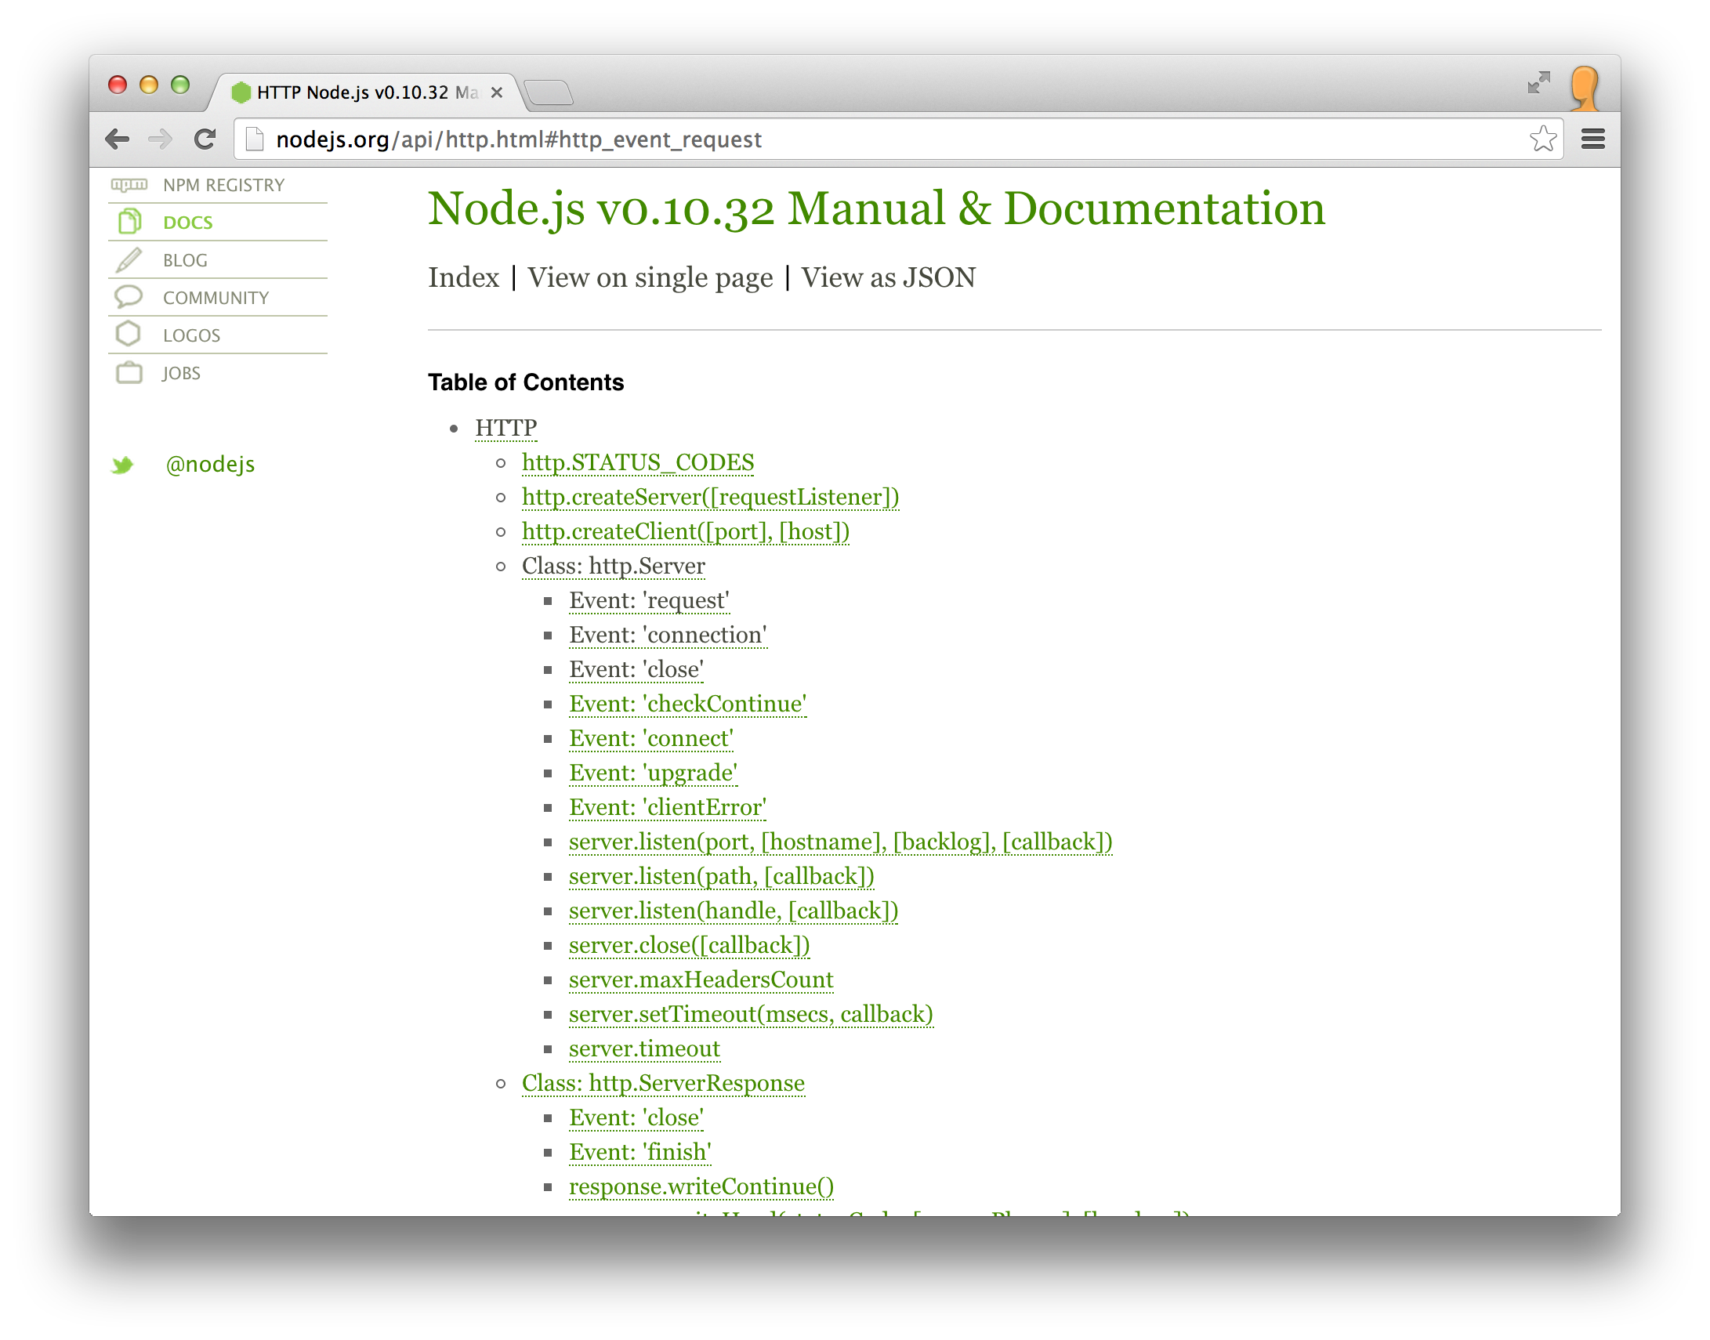
These are the events that are emitted by the class. You can write callbacks and react to these events.

Slide 46

How does Node.js use an event loop to offer an asynchronous programming model?
on('request', function(req, res) { // my code});
on('data', function(data) { // my code});
Callback functions that you have written and registered
'request' event
'request' event
Event Loop
'data' event
get the next event in the queue; invoke the registered callbacks in sequence; delegate I/O operations to the Node platform
'request' event
Queue of events that have been emitted
All the code that you write runs on a single thread
The long-running tasks (I/Os) are executed by Node in parallel; Node emits events to report progress (which triggers your callbacks).
Another pattern is to provide a callback to node when invoking an asynchronous function.

Slide 47
What is npm?
”npm is the package manager for the Node JavaScript platform. It puts modules in place so that node can find them, and manages dependency conflicts intelligently.
It is extremely configurable to support a wide variety of use cases. Most commonly, it is used to publish, discover, install, and develop node programs.”
https://www.npmjs.org/doc/cli/npm.html
You have to read this:
https://www.npmjs.org/doc/misc/npm-faq.html

Slide 48
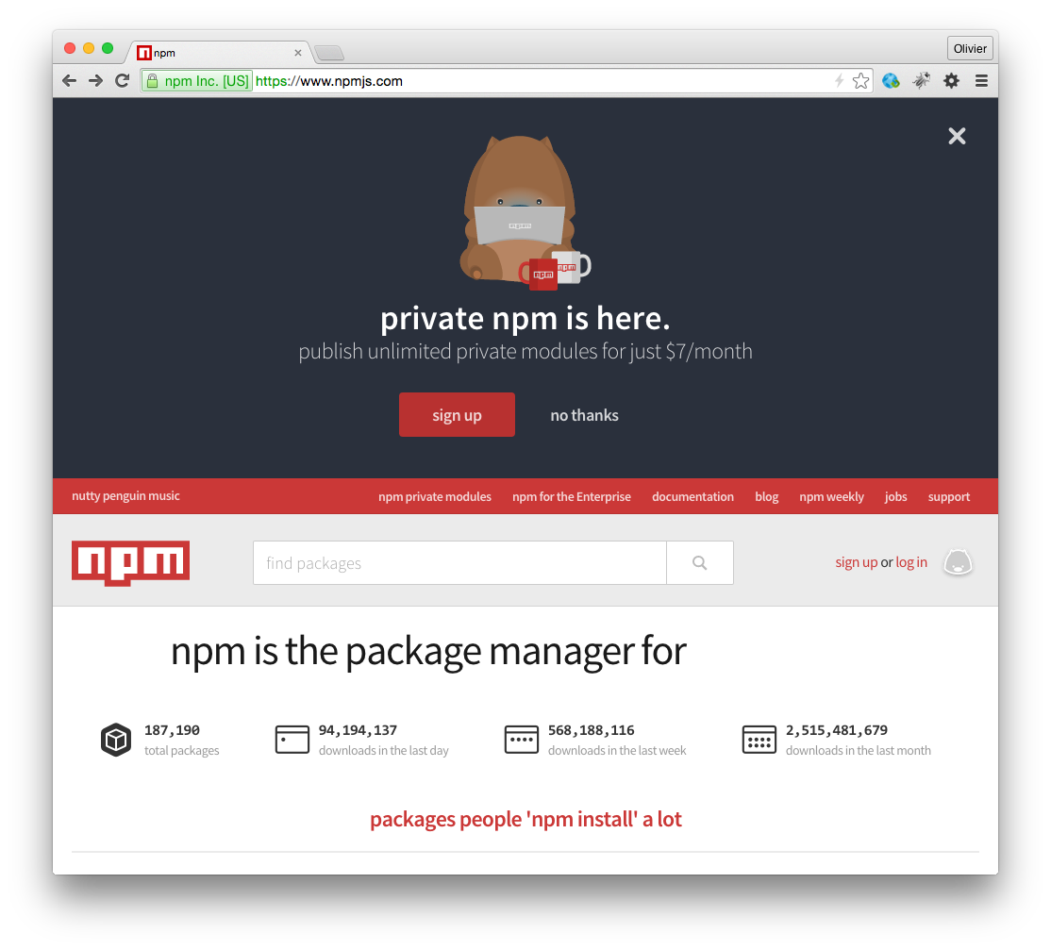
npm is a set of command line tools that work together with the node registry
https://www.npmjs.org

Slide 49
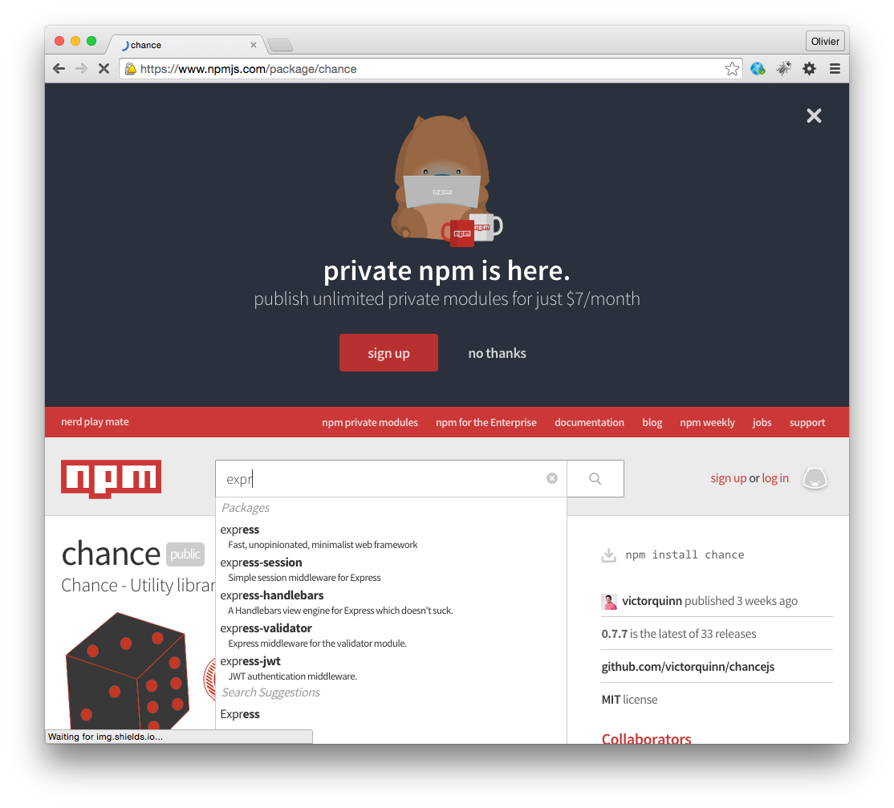
npm is a set of command line tools that work together with the node registry
https://www.npmjs.org

Slide 50
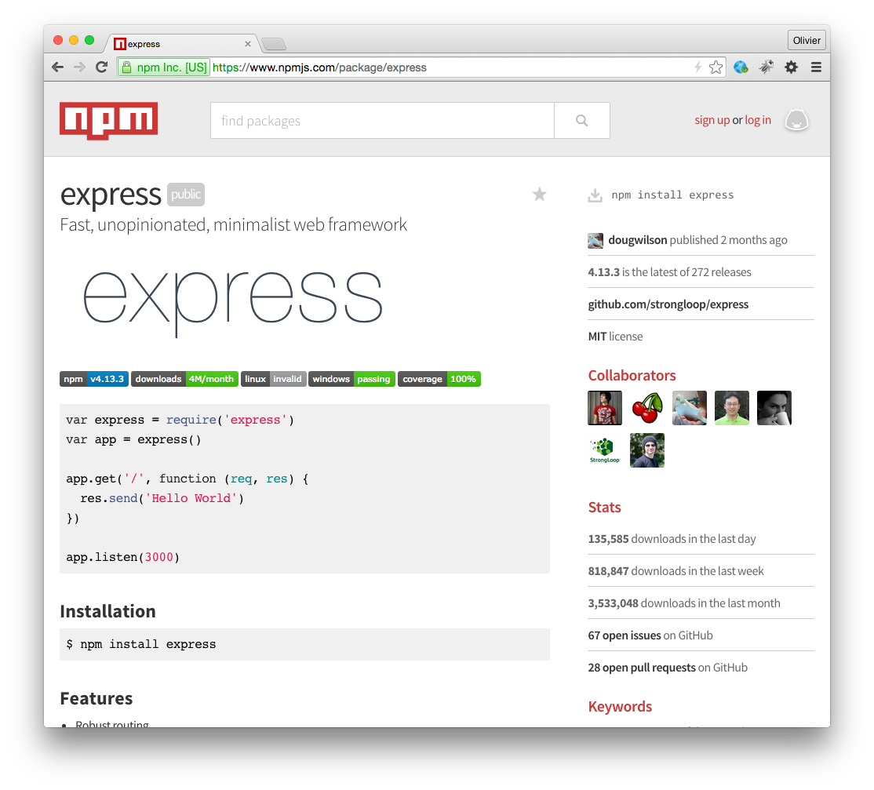
npm is a set of command line tools that work together with the node registry
https://www.npmjs.org

Slide 51
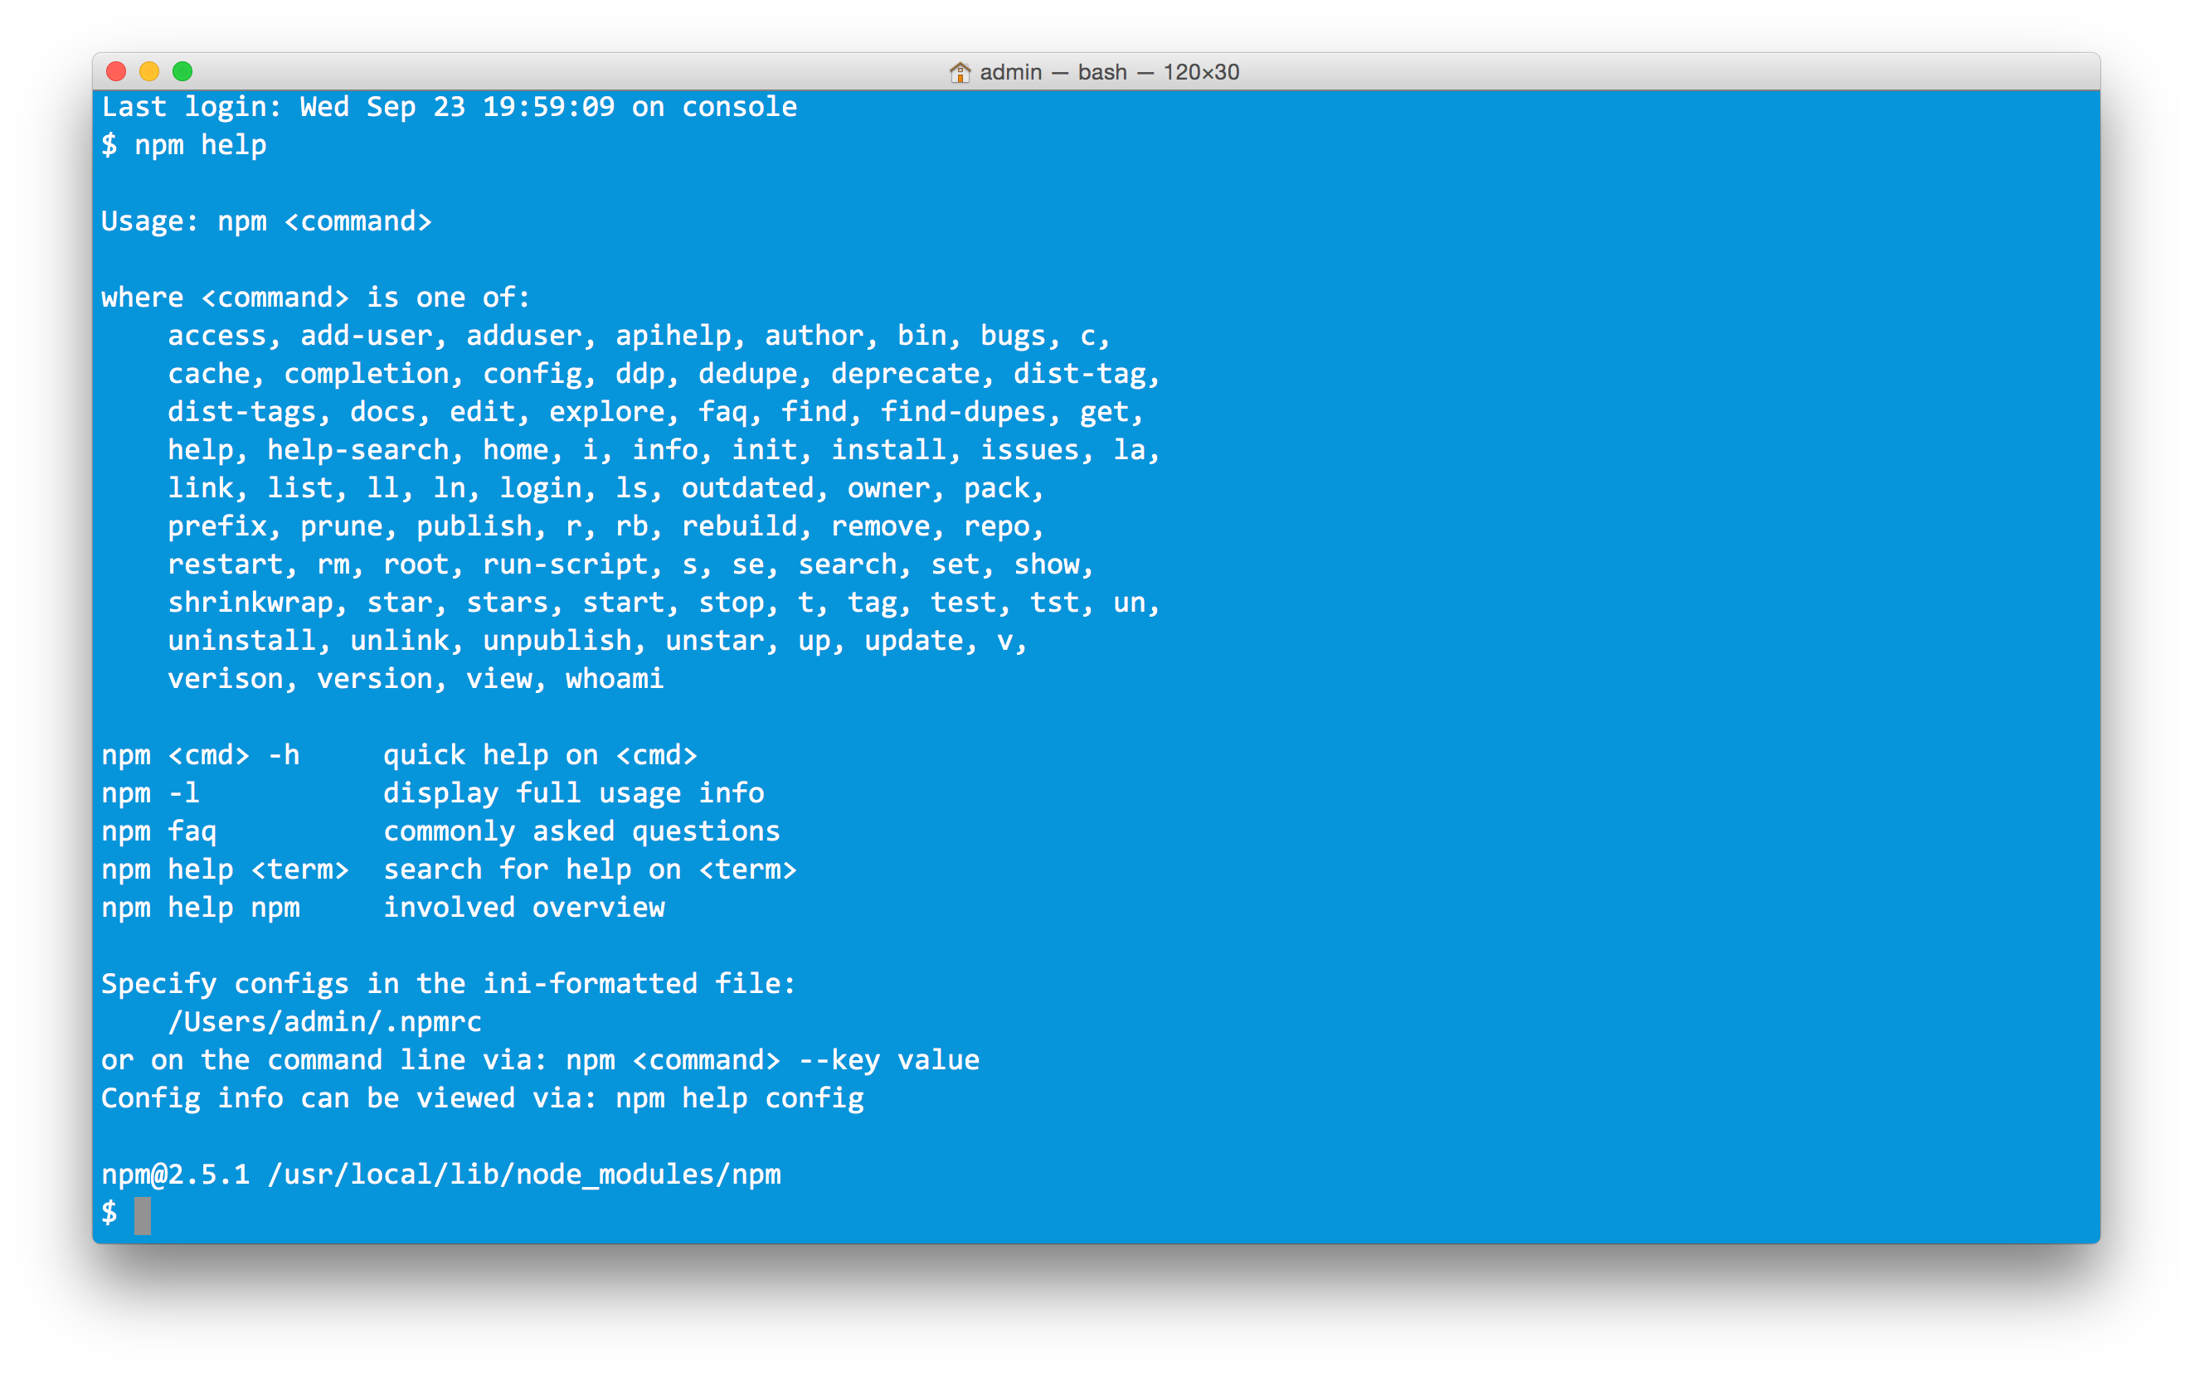


npm is a set of command line tools that work together with the node registry
init
install
publish
update

Slide 52

Example: 09-thermometers

Slide 53



node thermometer.js bedroom 17 2
Thermometer
node thermometer.js office 20 3
Thermometer
Thermometer
multicast
(239.255.22.5:9907)
node thermometer.js kitchen 20 5
Station
Station
node station.js

Slide 54
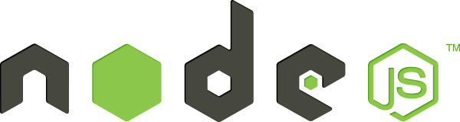
thermometer.js (fragment)
// We use a standard Node.js module to work with UDP
const dgram = require('dgram');
// Let's create a datagram socket. We will use it to send our UDP datagrams
const s = dgram.createSocket(‘udp4');
// Create a measure object and serialize it to JSON
const measure = new Object();
measure.timestamp = Date.now();
measure.location = that.location;
measure.temperature = that.temperature;
const payload = JSON.stringify(measure);
// Send the payload via UDP (multicast)
message = new Buffer(payload);
s.send(message, 0, message.length, protocol.PROTOCOL_PORT, protocol.PROTOCOL_MULTICAST_ADDRESS, function(err, bytes) {
console.log("Sending payload: " + payload + " via port " + s.address().port);
});

Slide 55
station.js (fragment)
// We use a standard Node.js module to work with UDP
const dgram = require('dgram');
// Let's create a datagram socket. We will use it to listen for datagrams published in the
// multicast group by thermometers and containing measures
const s = dgram.createSocket('udp4');
s.bind(protocol.PROTOCOL_PORT, function() {
console.log("Joining multicast group");
s.addMembership(protocol.PROTOCOL_MULTICAST_ADDRESS);
});
// This call back is invoked when a new datagram has arrived.
s.on('message', function(msg, source) {
console.log("Data has arrived: " + msg + ". Source IP: " + source.address + ". Source port: " + source.port);
});

